Slide 1

FACE RECOGNIZER
UNIVERSITY WITH A PURPOSE
Department of Cybernetics,
School of Computer Science
University Of Petroleum And Energy Studies
Mentor :
Ms. Nitika Goenka
Presented By:
Kartik Tyagi Sahil Sangwan Shubham Patel R100218024 R100218050 R100216088

Slide 2
PROBLEM STATEMENT
To build a face recognizer which can detect a face and classify it as authorized or unauthorized for security purposes.

Slide 3
FACE RECOGNITION (identifying a face match)

Slide 4

What is face recognition?
Face recognition is the task of identifying an already detected face as a KNOWN or UNKNOWN face, and in more advanced cases,
TELLING EXACTLY WHO’S IT IS!

Slide 5
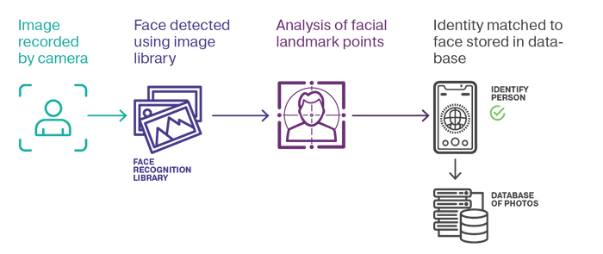
How it works?
Fig 1.1 Face recognition

Slide 6
FACE RECOGNITION USING
OpenCV
(including Haar Cascades and face_LBPHFaceRecognizer)

Slide 7

What is OpenCV? (Open Source Computer Vision Library)
OpenCV is an open source computer vision and machine learning software library built to provide a common infrastructure for computer vision applications and to accelerate the use of machine perception in the commercial products.

Slide 8
Why OpenCV?
Contains a library of programming functions mainly aimed real-time computer vision.
The library is cross-platform free for use under Open Source BSD license.
Major applications are object, face and gesture recognition, lip reading, Human- Computer Interaction(HCI), motion detection and much more.

Slide 9
HAAR CASCADES
(devised by Paula and Michael Jones in 2021)
04-06-2021

Slide 10
Face detection using Haar Cascades
Robust and very quick.
15 times quicker than any technique at time of release.
Could be operated in real time.(95% accuracy at around 17fps)
Feature extraction and feature evaluation.
Classifier training and feature selection using a method called AdaBoost.

Slide 11
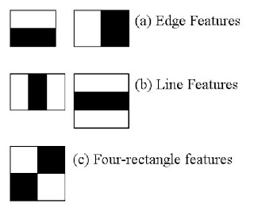
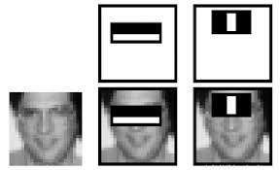
Feature’s and its extraction

Slide 12
CHALLENGES
Variations in pose
Illumination changes
Camera parameters
Occlusion

Slide 13
Advantages, and Disadvantages
High Detection Accuracy
Low false positive ratec
Computationally complex and slow
Longer training time.
Limitation in difficult lightening conditions.
Less robust to occlusion/obstacle

Slide 14
OBJECTIVE
To build a face detector.
To improve its functionality to face recognizer (for classifying detected face as authorized or unauthorized).

Slide 15
PERT CHART
Module 1:
(February)
Module 2:
(March)
Module 3:
(April)
Start: Requirement Analysis
(January)
Creation Of Data Set
Training Over Data Set
Detection in Live Cam
End

Slide 16
Creation Of Data Set
04-06-2021
04-06-2021
16

Slide 17
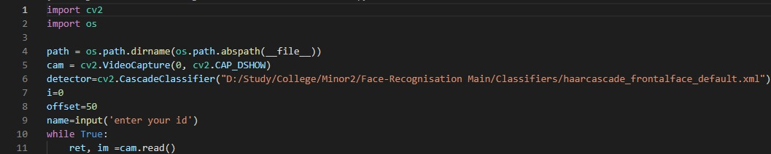
This part of code deals with the extraction of faces for the purpose of training the system. The module (In simple terms): -
Step 1: - Getting a video stream. The module on running shall ask for the type of new face you want to register with the system.
Step 2: - Scans the frame for Faces. Here for time efficiency we use the inbuilt function of cv2 module i.e. cv2. CascadeClassifier (a part of haarcascades). However, one can use neural networks for even better face detection.

Slide 18
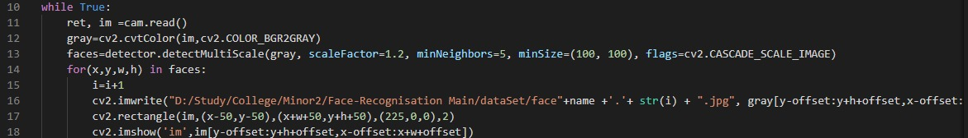
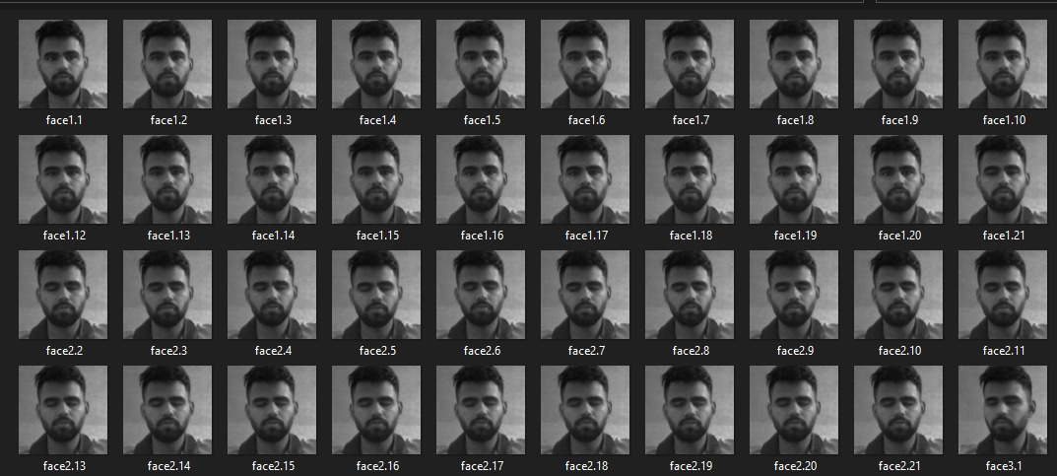
Step 3: - Takes the detected faces and standardises them (size matching and grayscale conversion). The faces detected are then converted to grayscale image and then resized to 100 x 100 resolution.
Step 4: - Save the standardised face images as .jpg files. The images are saved in a jpeg format. The authorized face images are stored in one folder while the other (test cases) folder contains random images of unknown people, increasing the number of which shall increase the accuracy of the model.

Slide 19
Training Over Data Set
04-06-2021
04-06-2021
19

Slide 20
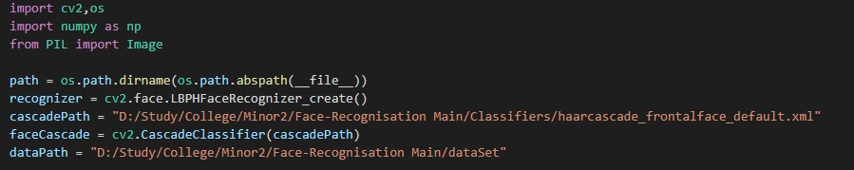
In this Module the extracted jpeg images are scanned and converted to the Face Recognizer Model – the LBPHFaceRecognizer. The process to create the training data from jpeg files is shown below: -
Step 1: - Read the image path from the stored data. Here we use OpenCV’s face recognition algorithm LBPHFaceRecognizer.

Slide 21
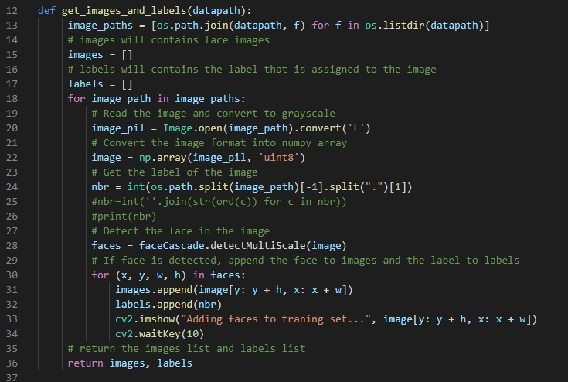
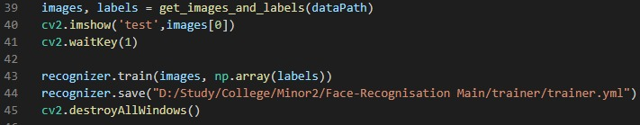
Step 2: - Train the data for authorized and unauthorized images. The efficiency of the model increases when we train for maximum number of unauthorized faces. We take images [] and labels [] as two empty lists which will store the extracted face data and the type of face it is to be trained as respectively
Step 3: - Storing of the trained data in the yml file.

Slide 22
Detection In Live Cam
04-06-2021
04-06-2021
22

Slide 23
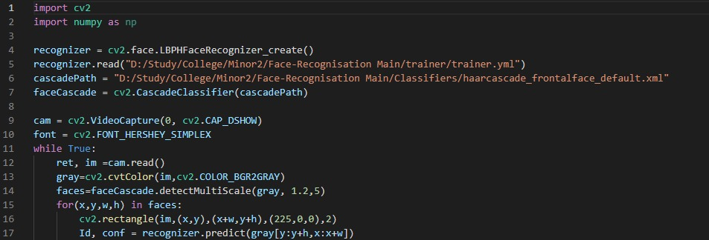
In this module we are going to check whether the image of the face we are showing to the camera is an authorized face or not based on the previously trained data we have stored in the XML file. This process is executed in the following stated steps:
Step 1: - Initialising of our LBPHFaceRecognizer model. and starting the video stream. Here the project can accept the input video stream i.e Using Webcam of the computer (Local device). This involves the capturing of the Video stream of the webcam using the cv2’s VideoCapture function.
Step 2: - Detection of Face using Haarcascades. The faces are extracted from the video streams using the inbuilt Haarcascades files in openCv2.

Slide 24
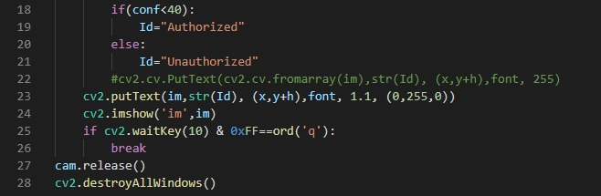
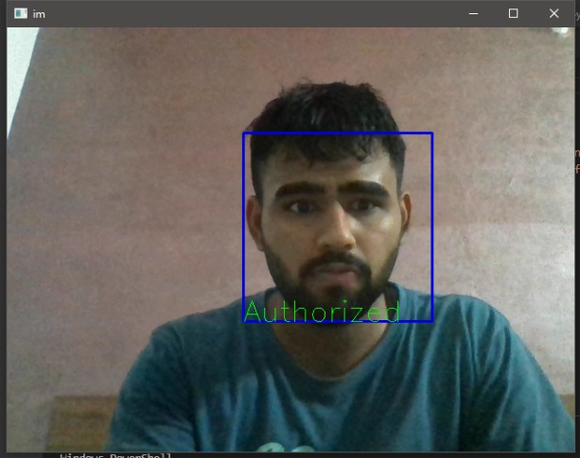
Step 3: - Classification of face as Authorized/Unauthorized We use the trained LBPHFaceRecognizer to predict whether the face detected is authorized or not checking the id predicted by the model.
Step 4: - Displaying the results. In this final step we prepare the text to be displayed by the system and display the detected face as either authorized face or unauthorized.

Slide 25
APPLICATIONS
The applications of this project are numerous, some of which are stated below: -
Security.
Cheap Biometric based recognition.
Entry Exit system (House Entry control from remote location)
Attendance Management system.
Intrusion alerts.
Possible suspects recognition in high alert zones and so on.

Slide 26
SCOPE OF IMPROVEMENT
This project has a variety of fields which can be improved they are numerated below: -
A thermal/infrared camera can be used instead of the default webcams allowing the software to detect and recognise faces even in dark conditions.
Providing a variety of faces for the unauthorized section. This will make the system more robust towards new faces and more reliable.
A Neural Network based model can be used instead of the default LBHFRecogniser. This will drastically improve the accuracy of the model.
Instead of using the haarcascades module for face detection, one can use CNN to improve the software’s ability to recognise even tilted or partial faces improving the overall dependability of the software.

Slide 27
REFERENCES
IEEE Visual Surveillance; DorinComaniciu and Visvanathan Ramesh
International Journal of Soft Computing and Artificial Intelligence. ; MAMATA S. KALAS
IJCTA, vol. 2. Nandita Sethi and Alankrita Aggarwal.
Department of Electrical Engineering, Polytechnic University, Brooklyn. Zhu Liu and Yao Wang
Pulsar team, INRIA. Etienne Corvee and Francois Bremond.
ARPN Journal of Engineering and Applied Sciences. 10(17): 7678-7683. Divya George and Arunkant A. Jose.
s. Conference on Computer Vision and Pattern Recognition. Paul Viola and Michael Jones.
IEEE Trans. On Pattern Analysis and Machine Intelligence. L. Stan and Z. Zhang
Conference on Computer Systems and Technologies. Peter Gejgu and Martin perka
International Journal of Computer Vision, 57:137154, 2004. Paul Viola and Michael Jones
Mitsubishi Electric Research Lab TR2000396, (July), 2003. M Jones and P Viola

Slide 28
Thank You!!!

